Slide 1
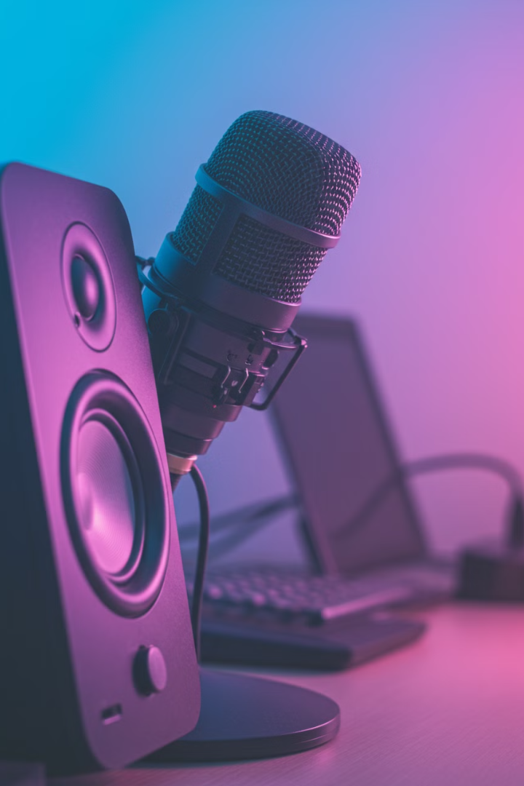

Speakers & Microphones:
How They Work in a Computer
Speakers and microphones are important devices that help you hear sound and record your voice on a computer.
by Ram N Java

Slide 2
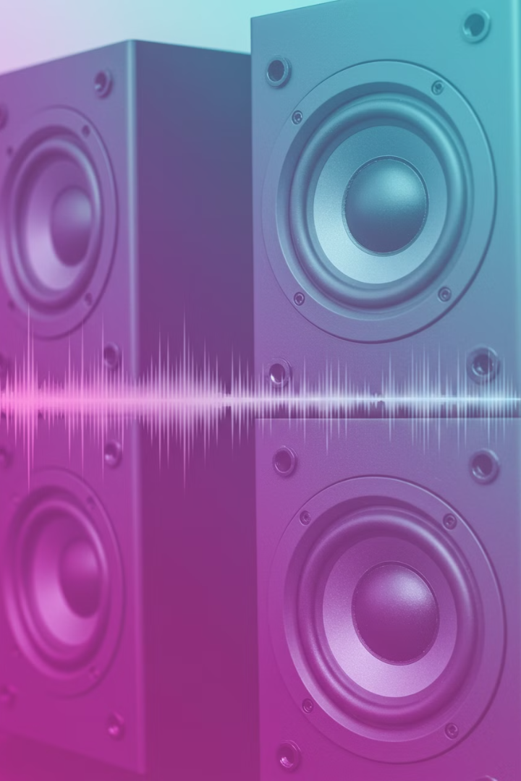
Speakers
What Are Speakers?
Purpose
Speakers are devices that play sound from your computer. They let you hear music, videos, games, and other audio.
They convert electrical signals from your computer into audible sound waves that you can hear.

Slide 3
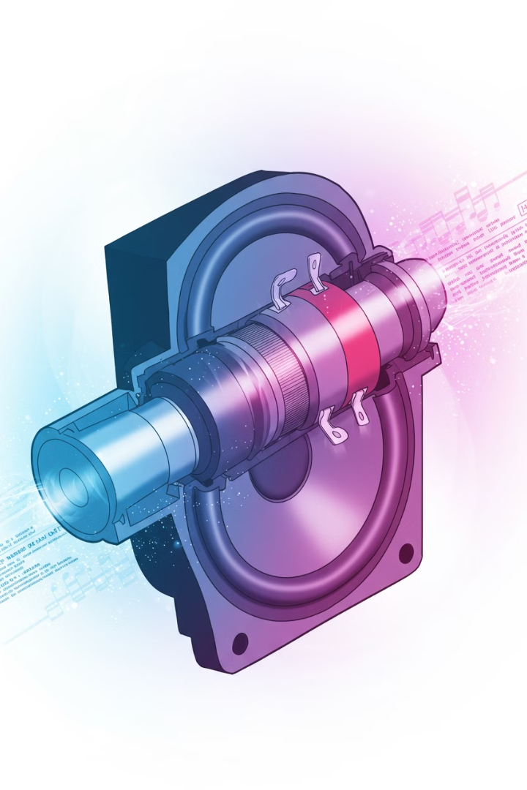



How Do Speakers Work?
Sound Signals
The computer sends sound signals (electrical signals) to the speakers.
Example: When you play a song, the computer sends the music data to the speakers.
Converting Signals to Sound
Inside the speakers, there's a magnet and a coil that work together to move a cone (the round part of the speaker).
When the electrical signals reach the speakers, they make the cone vibrate.
These vibrations create sound waves that you can hear.
Volume Control
You can adjust the volume using the computer's settings or buttons on the speakers.
Example: Turn up the volume to hear music louder.

Slide 4




Types of Speakers:
Built-in Speakers
Some computers, like laptops, have small speakers built into them.
Example: Laptop speakers for basic sound.
External Speakers
These are separate speakers you connect to the computer for better sound quality.
Example: Desktop speakers for gaming or watching movies.
Bluetooth/Wireless Speakers
Connect without wires.

Slide 5
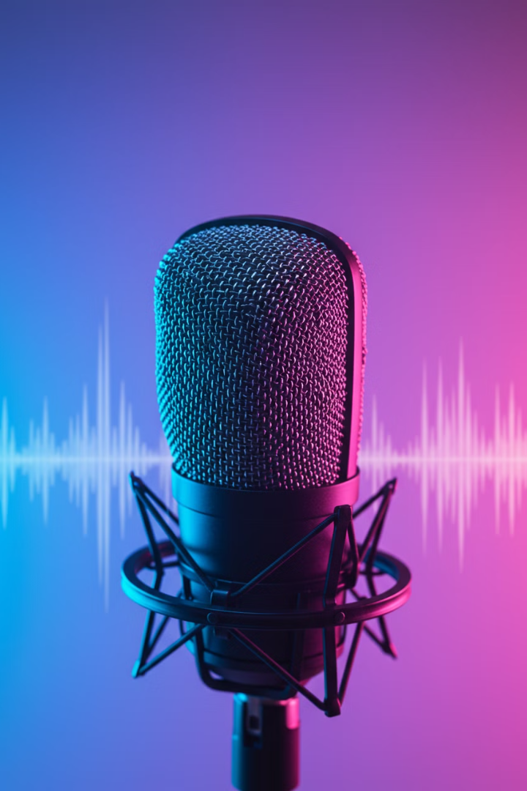


Microphones
Purpose
Function
Microphones are devices that record sound or capture your voice. They let you talk to others, record audio, or give voice commands.
They convert sound waves from your voice into electrical signals that your computer can process and store.

Slide 6
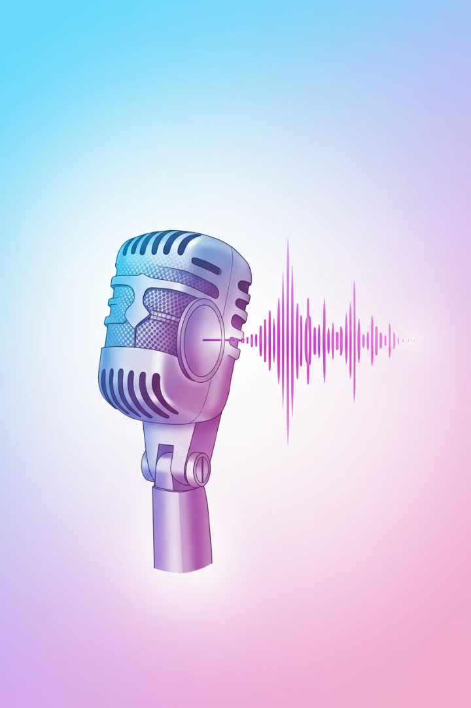



How Do Microphones Work?
Capturing Sound
When you speak or make noise, the microphone picks up the sound waves.
Example: Talking into a microphone during a video call.
Converting Sound to Signals
Inside the microphone, there's a diaphragm (a thin piece of material) that vibrates when sound hits it.
These vibrations are converted into electrical signals.
Sending Signals to the Computer
The electrical signals are sent to the computer, where they are processed and saved as audio files or sent to others.
Example: Your voice is recorded as an audio file or transmitted during a call.

Slide 7
Types of Microphones:
Built-in Microphones
External Microphones
Some computers, like laptops, have small microphones built into them.
These are separate microphones you connect to the computer for better sound quality.
Example: Laptop microphones for video calls.
Example: USB microphones for recording podcasts or music.
Convenient and always available
Higher audio quality
Typically lower quality
Better noise isolation
Good for casual use
More control over positioning

Slide 8


How Speakers and Microphones Work Together
For Voice Calls
Recording
You speak into the microphone, and the sound is sent to the other person's speakers.
You record your voice using the microphone, and the computer saves it as an audio file.
Example: Talking to a friend on a video call.
Later, you can play the recording through the speakers.
Example: Recording a song and playing it back.

Slide 9





Tips for Using Speakers and Microphones
Positioning
Place speakers at ear level for the best sound.
Keep the microphone close to your mouth but not too close to avoid distortion.
Adjust Settings
Use the computer's sound settings to adjust volume, input (microphone), and output (speakers).
Test Before Use
Test your microphone and speakers before important calls or recordings to make sure they work properly.
Keep Devices Clean
Dust can affect sound quality. Clean your speakers and microphone regularly.

Slide 10






Summary
Communication
Together, they enable digital audio interaction
Speakers
Play sound by converting electrical signals into sound waves
Microphones
Record sound by converting sound waves into electrical signals
Speakers: They play sound by converting electrical signals into sound waves. Use them to listen to music, videos, or calls.
Microphones: They record sound by converting sound waves into electrical signals. Use them to talk, record, or give voice commands.
Together, speakers and microphones help you hear and communicate on your computer. With these basics,
you'll be able to use them confidently!

